Slide 1

CSC 406: Net-Centric Computing Lecture 5 Virtualization: Case Study
2nd Semester (2022/2023 session) 1445h
FEDERAL UNIVERSITY BIRNIN KEBBI
DEPARTMENT OF COMPUTER SCIENCE

Slide 2
Reading
Modern Operating Systems, Tanenbaum (4th Edition): Chapter 7
Tanenbaum (2nd Edition): 3.2
Coulouris (5th Edition): 4.5, 7.7
A compilation from the EMC Lecture Notes: Cloud Infrastructure and Services

Slide 3
Outline
Intro
Requirements for Virtualization
Type 1 and Type 2 Hypervisor
Techniques for Efficient Virtualization
Memory Virtualization

Slide 4
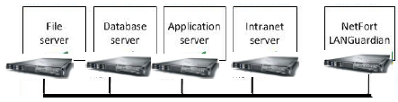
Intro
A company with multiple servers connected with high speed internet.
File server, DB server, FTP server, ...
Objective:
One machine might not be able to handle the load.
Reliability.
Security.

Slide 5
Intro
Problem
Large companies support many service applications
File server, mail server, web server, database server, ….
Each service application demands its own environment
Specific version of operating system.
Multiple processors and disks.
Specialized configurations.
Running multiple service applications on the same server
Vulnerable to conflicting demand.
Load balancing might be hard.

Slide 6
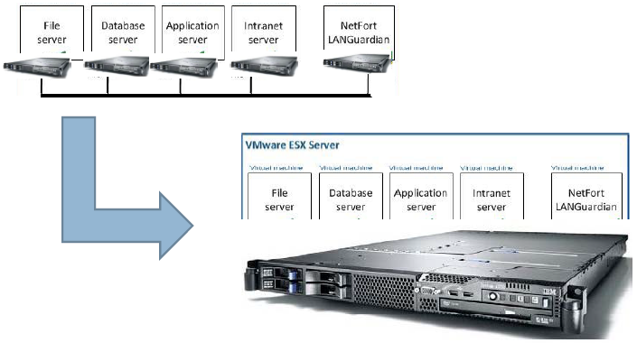
Intro

Slide 7
Intro
Solution: Virtualization
Decouple [OS, service] pair from hardware.
Multiplex lightly‐used services on common host hardware.
Migrate services from host to host as needed.
Introduce new [OS, service] pairs as needed
Adding new services.
Testing upgrades of existing services.
Experimental usage.

Slide 8
Why it is a Good Solution?
A failure in one virtual machine does not bring down any others.
Run multiple different operating systems on the same hardware.
Isolation
Good utilization of resources.
Economic solution, saves money.
Useful in trying put new ideas (testing).
Check pointing and migration is easy.
Run legacy applications on OS that are no longer supported.
Cloud.

Slide 9
Any Drawbacks?
Are we putting all the eggs in one basket?
Most service outages are not due to faulty hardware but due to unreliable software.
To implement virtual machines, only a hypervisor, which is much smaller than a kernel is running in supervisor mode. Therefore, two orders of magnitudes of fewer bugs.

Slide 10
Virtual Machine
A virtual machine provides interface identical to underlying bare hardware
I.e., all devices, interrupts, memory, page tables, etc.
Virtual Machine Operating System creates illusion of multiple processors
Each capable of executing independently
No sharing, except via network protocols
Clusters and SMP can be simulated

Slide 11
History
60s‐70s: IBM developed hypervisors for their IBM System/360 and later releases.
70s: UCLA researchers, Gerald Popek and Robert Goldberg:
definition of the formal requirements for virtualizations
Distinguish between type1 and type2 hypervisor
90s: Stanford researchers
Disco: Running Commodity Operating Systems on Scalable Multiprocessors
Founded Vmware
Xen, KVM, VirtualBox, Hyper‐V, Parallels

Slide 12
Requirements for Virtualization
Boot them like real machines and install operating system on them.
Safety: the hypervisor should have full control of the virtualized resources.
Fidelity: the behavior of a program on a virtual machine should be identical to that of the same program running on bare hardware.
Efficiency: much of the code in the virtual machine should run without intervention by the hypervisor.

Slide 13
Safety
Execute each command using an interpreter/emulator
Simple instructions such as increment can be executed by the interpreter.
Unsafe instructions need to be simulated by the interpreter.
The guest operating system should not be allowed to disable interrupts for the entire machine or modify the page table mapping. Yet, the guest operating system should think that it has disabled interrupts.

Slide 14
Fidelity
x86: instructions that behave differently if executed in kernel mode than when executed in user mode. ← sensitive instructions
x86: instructions that cause a trap if executed in user mode. ← privileged instructions
To guarantee that the behavior of running an application in virtual machine has the same behavior as running it on the bare hardware, the sensitive instructions should be a subset of the privileged instructions.

Slide 15
Virtualization Technology
IBM 370 had the fidelity property.
386 had instructions that violates fidelity.
Virtualization Technology (VT) introduced in 2005 for Intel and AMD CPUs and solved this problem by introducing containers to run the guest virtual machines in them.
Sensitive instructions executed inside the container will trap to the hypervisor.
Note: before 2005, vmware was rewriting sensitive instructions on the fly.

Slide 16
Paravertualization
It never aims to present a virtual machine that looks
like the actual underlying hardware.
Provides machine‐like software interface that explicitly exposes that it is a virtualized environment.
Offers a set of hypercalls, which allow the guest to send explicit requests to the hypervisor.
Guests use hypercalls for privileged sensitive operations.
Available since IBM VMs in 70s.
Drawback: guest OS should be aware of the virtual machine API.
Xen 1.0 is an example.

Slide 17
Outline
Requirements for Virtualization
Type 1 and Type 2 Hypervisor
Techniques for Efficient Virtualization
Memory Virtualization

Slide 18
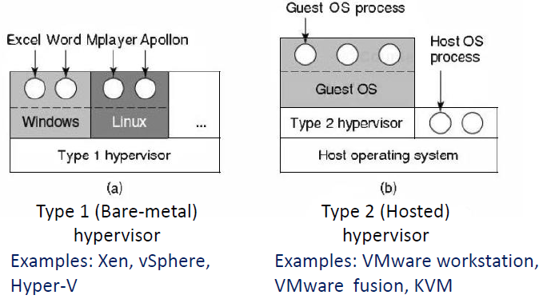
Type 1 and Type 2 Hypervisors

Slide 19
Guest and Host Operating Systems
Guest Operating System:
The operating system running on top of the hypervisor.
Applies to both type 1 and type 2 hypervisors.
Host Operating System:
The operating system running on the hardware.
Applies only to type 2 hypervisor.

Slide 20
Outline
Requirements for Virtualization
Type 1 and Type 2 Hypervisor
Techniques for Efficient Virtualization
Memory Virtualization

Slide 21
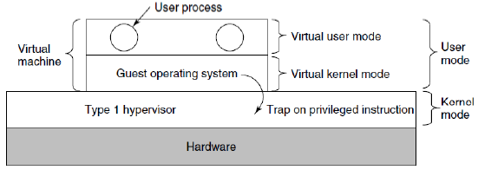
Efficient Virtualization
Virtual machines runs as a user process in user mode
sensitive instructions not allowed.
Guest operating system thinks that it is run in kernel mode. ← virtual kernel mode
Guest OS executes a sensitive instruction:
CPU without VT: instruction fails, virtual machine crashes.
CPU with VT: trap to the hypervisor, emulates instruction if issued by guest operating .

Slide 22
Outline
Requirements for Virtualization
Type 1 and Type 2 Hypervisor
Techniques for Efficient Virtualization
Memory Virtualization
I/O Virtualization

Slide 23
Memory Virtualization
Why memory virtualization?
Multilevel page table is used to define the mapping between physical addresses and logical addresses.
Each virtual machine thinks that it has all of the physical memory.
For a virtual machine to change the mapping of pages in memory, it executes a sensitive instruction:
Traps and will need to be executed by the hypervisor.
In paravertualized OS, it will be performed through a hypercall.

Slide 24
Shadow Page Table
Each virtual machine thinking that it is the only one allocating memory.
Multiple virtual machines can allocate pages to the same physical memory pages.
The hypervisor needs to maintain the actual mapping between what pages are allocated by the virtual memory and what pages are actually allocated by the hypervisor. ← shadow page table
Challenge: every time a virtual machine change its page table, they hypervisor needs to change its shadow page table.

Slide 25
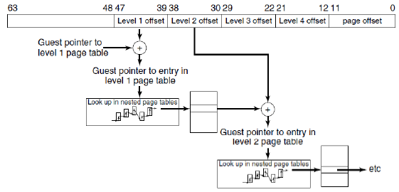
Extended Page Tables
Handle the shadow page table using hardware, no traps (software) involved.
We now have: guest virtual address, guest physical address, host (machine) physical address.

Slide 26
Case Study:
Virtualized Data Center

Slide 27
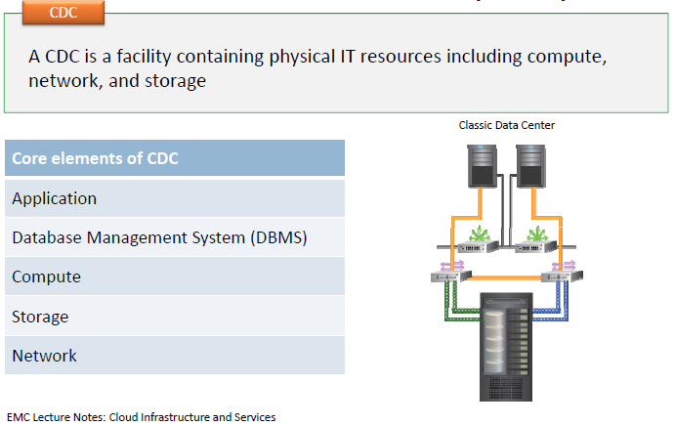
Classic Data Center (CDC)

Slide 28
Main Elements of a Classic Data Center
Compute:
Compute consists of physical components (hardware devices) and logical components (software and protocols).
Storage:
It is a resource that stores data persistently for subsequent use.
Network:
Facilitates communication between clients and compute systems or between compute systems and storage.

Slide 29
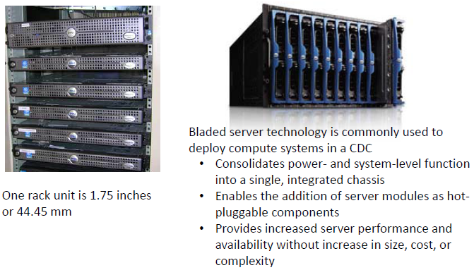
Compute: Rack and Blade Severs

Slide 30
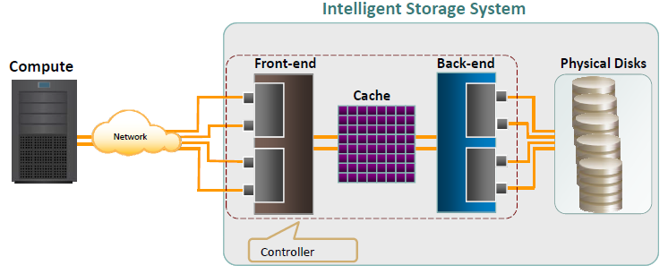
Components of Intelligent Storage System

Slide 31
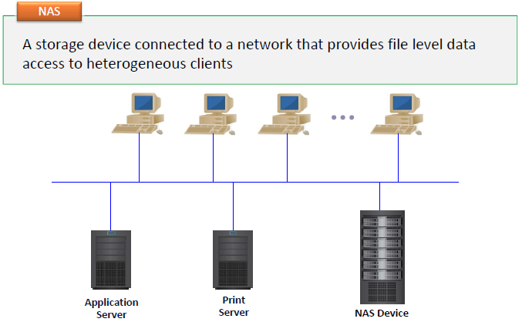
Network Attached Storage (NAS)

Slide 32
Storage Area Network (SAN)
It is a high‐speed, dedicated network of servers and shared storage devices.
Centralizes storage and management.
Enables sharing of storage resources across multiple servers at block level.
Meets increasing storage demands efficiently with better economies of scale.
Common SAN deployments are:
Fibre Channel (FC) SAN: uses FC protocol for communication.
IP SAN: uses IP‐based protocols for communication.

Slide 33
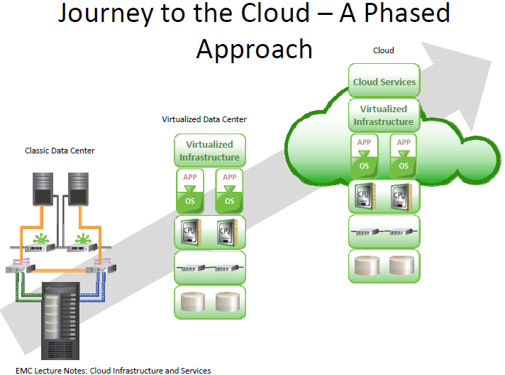

Slide 34
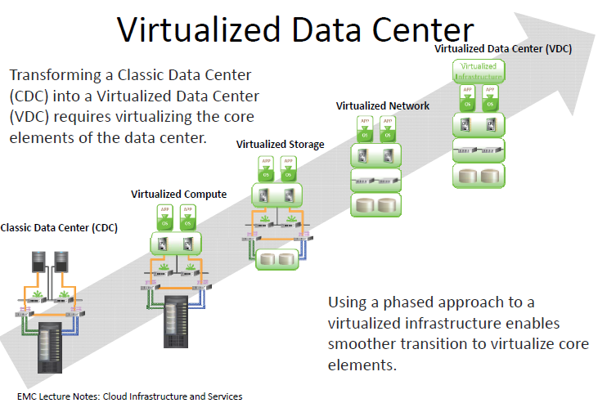

Slide 35
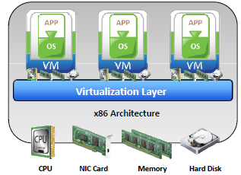
System/Compute Virtualization
It is a technique of masking or abstracting the physical compute hardware and enabling multiple operating systems (OSs) to run concurrently on a single or clustered physical machine(s).
A virtual machine (VM ) is a logical entity that looks and behaves like physical machine.
Goal: multiple VMs, each running a separate OS.
Hypervisor or Virtual Machine Monitor: a virtualization layer resides between hardware and VMs.
provides an interface based closely on the underlying physical architecture.
offers an identical interface to the underlying physical architecture.

Slide 36
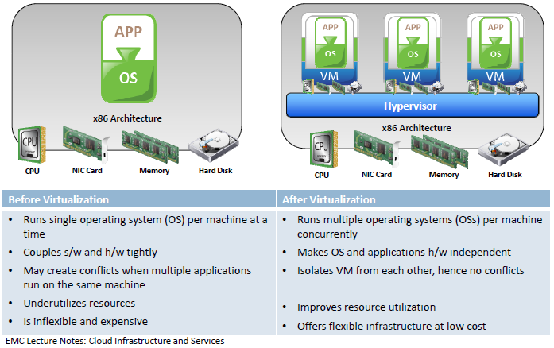
Advantages of Virtualization

Slide 37
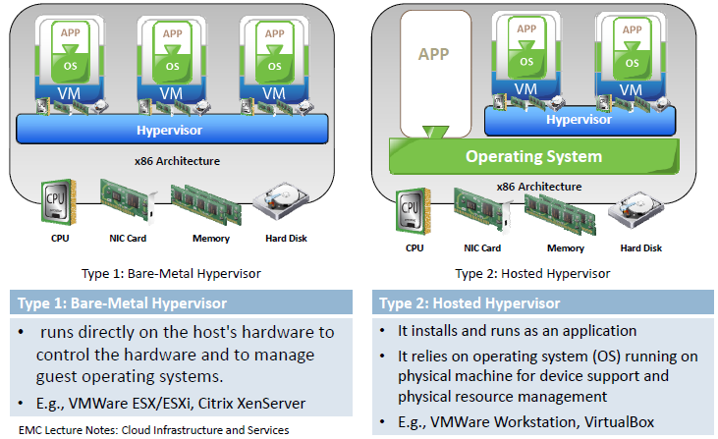
Types of Hypervisor

Slide 38
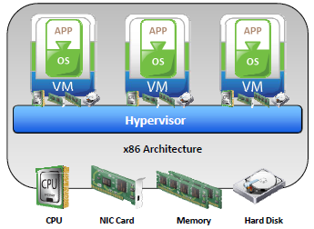
Virtual Machines
From a user’s perspective:
Runs an operating system (OS) on a physical machine.
Contains virtual components such as CPU, RAM, disk, and NIC.
From a hypervisor’s perspective:
Virtual machine (VM) is a discrete set of files, such as:
configuration file,
virtual disk files,
virtual BIOS file,
VM swap file, and
log file.

Slide 39
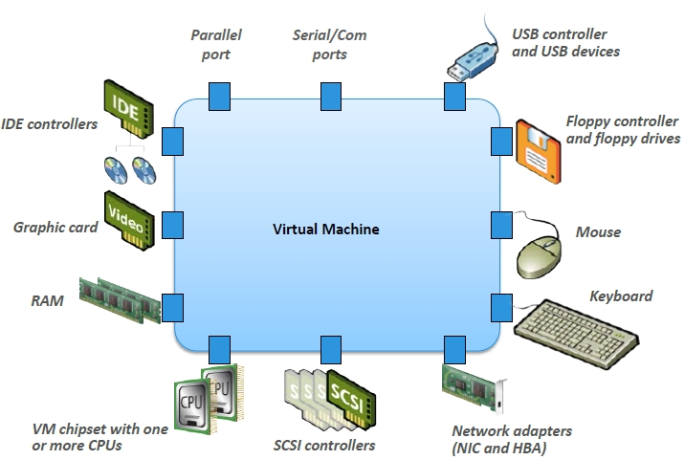
Virtual Machine Hardware

Slide 40
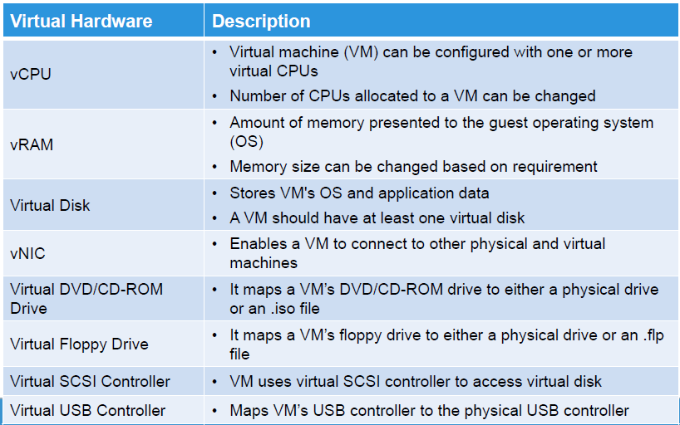
VM Hardware Components

Slide 41
VM Resource Management
A process of allocating resources from physical machine or clustered physical machines to virtual machines (VMs) to optimize the utilization of resources.
Goals of resource management:
Controls utilization of resources.
Prevents VMs from monopolizing resources.
Allocates resources based on relative priority of VMs.
Resources must be pooled to manage them centrally.
A resource pool is a logical abstraction of aggregated physical resources that are managed centrally.

Slide 42
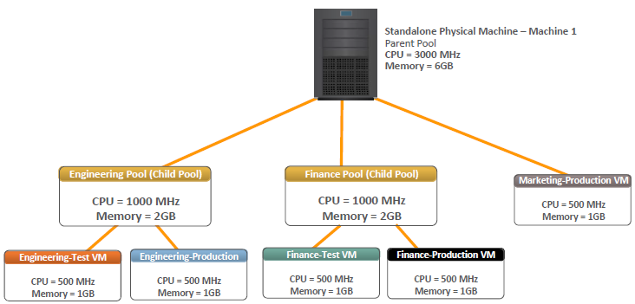
Example of Resource Pool Management

Slide 43
Optimizing CPU Resources
Modern CPUs are equipped with multiple cores and hyper‐threading
Multi‐core processors have multiple processing units (cores) in a single CPU.
Hyper‐threading makes a physical CPU appear as two or more logical CPUs.
Allocating a CPU resource efficiently and fairly is critical.
Hypervisor schedules virtual CPUs on the physical CPUs.
Hypervisors support multi‐core, hyper‐threading, and CPU load‐balancing features to optimize CPU resources.

Slide 44
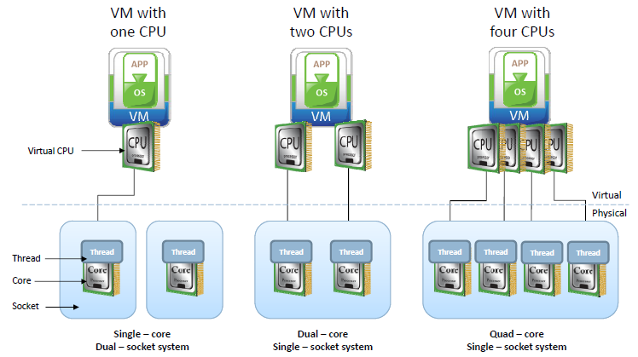
Multi‐core Processors

Slide 45
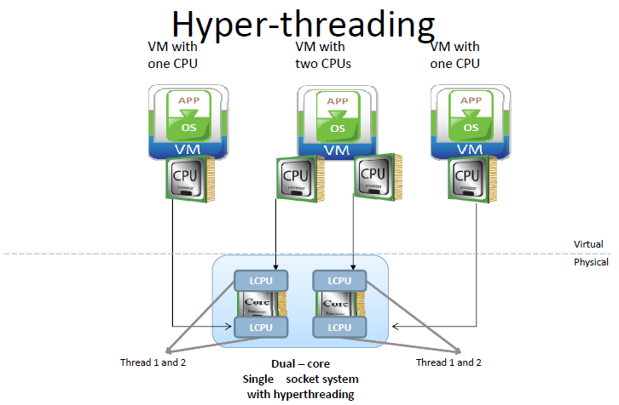

Slide 46
Optimizing Memory Resources
Hypervisor manages a machine’s physical memory
Part of this memory is used by the hypervisor.
Rest is available for virtual machines (VMs).
VMs can be configured with more memory than physically available, called ‘memory over commitment’
Memory optimization is done to allow over commitment.
In order to effectively support memory over commitment, the hypervisor provides efficient physical memory reclamation techniques.

Slide 47
Outline
Introduction
Classic Data Centers
Virtualized Data Centers
Virtualized Compute
Virtualized Storage
Virtualized Network

Slide 48
Virtualized Data Storage
It is the process of masking the underlying complexity of physical storage resources and presenting the logical view of these resources to compute systems.
Logical to physical storage mapping is performed by virtualization layer.
Virtualization layer abstracts the identity of physical storage devices
Creates a storage pool from multiple, heterogeneous storage arrays.
Virtual volumes are created from the storage pools and are assigned to the compute system.

Slide 49
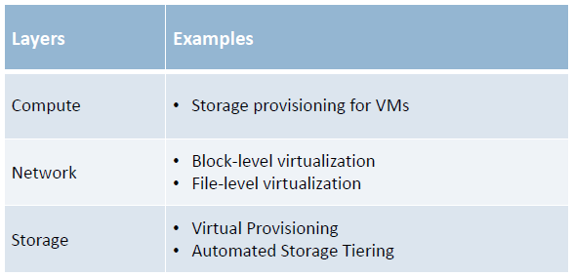
Storage Virtualization at Different Layers

Slide 50
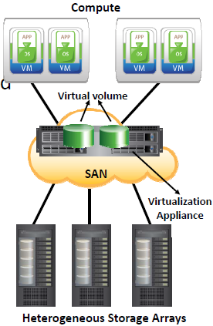
Block Level Storage Virtualization
Creates an abstraction layer at SAN, between physical storage resources and volumes presented to compute
Uses virtualization appliance to perform mapping operation
Makes underlying storage infrastructure transparent to compute
Enables significant cost and resource optimization

Slide 51
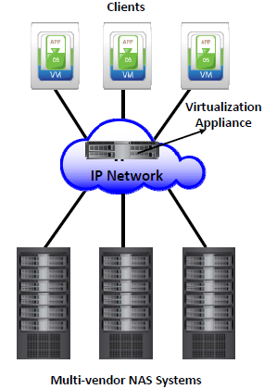
File Level Storage Virtualization
Provides an abstraction in the NAS/File servers environment
Eliminates dependencies between the file and its location
Enables movement of files between NAS systems without impacting client access
Provides opportunities to optimize storage utilization
Implemented using global namespace

Slide 52
Outline
Introduction
Classic Data Centers
Virtualized Data Centers
Virtualized Compute
Virtualized Storage
Virtualized Network

Slide 53
Network Virtualization
It is a process of logically segmenting or grouping physical network(s) and making them operate as single or multiple independent network(s) called “Virtual Network(s)”.
Enables virtual networks to share network resources.
Allows communication between nodes in a virtual network without routing of frames.
Enforces routing for communication between virtual networks.
Restricts management traffic, including ‘Network Broadcast’, from propagating to other virtual network.

Slide 54
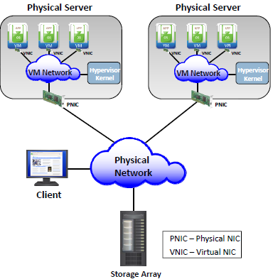
VM Network
Resides inside a physical server.
Consists of logical switches called “ virtual switches”.
Provides connectivity among VMs inside a physical server.
Provides connectivity to Hypervisor kernel.
Connects to physical network.

